Slide 3
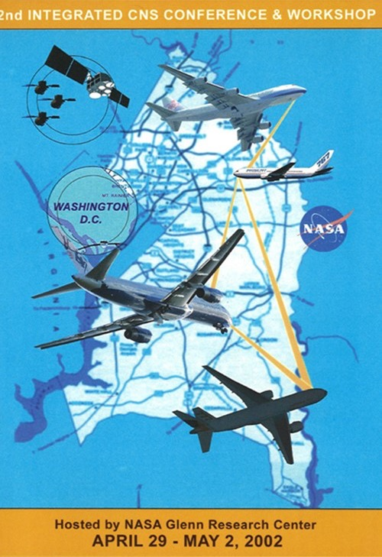

Slide 7
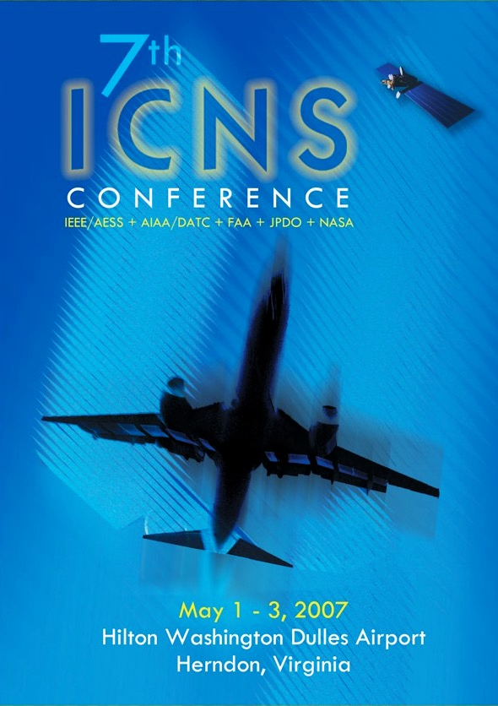

Slide 9
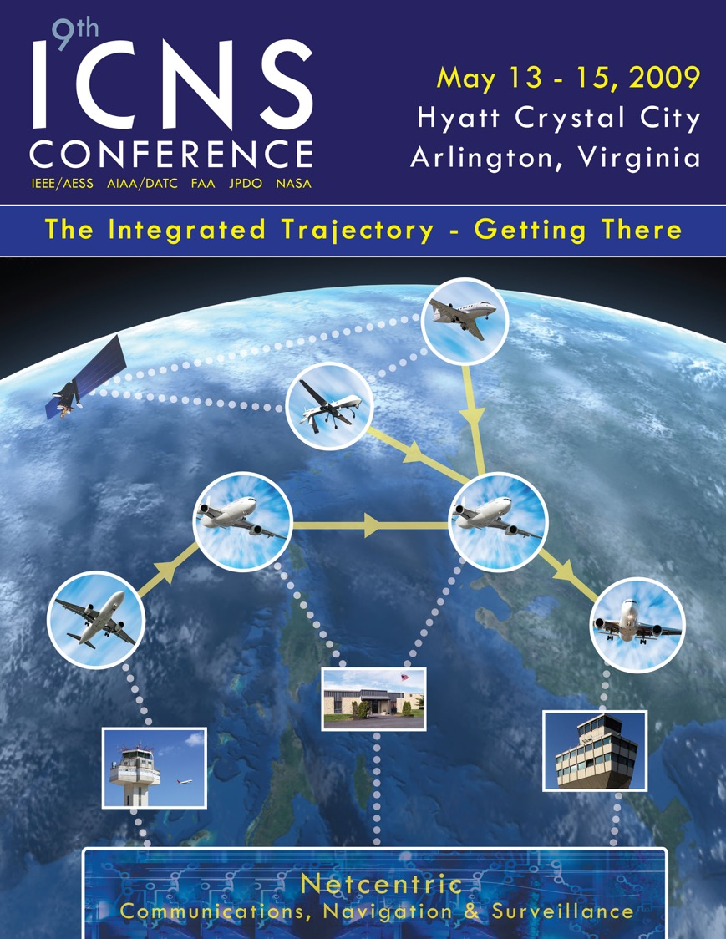

Slide 10
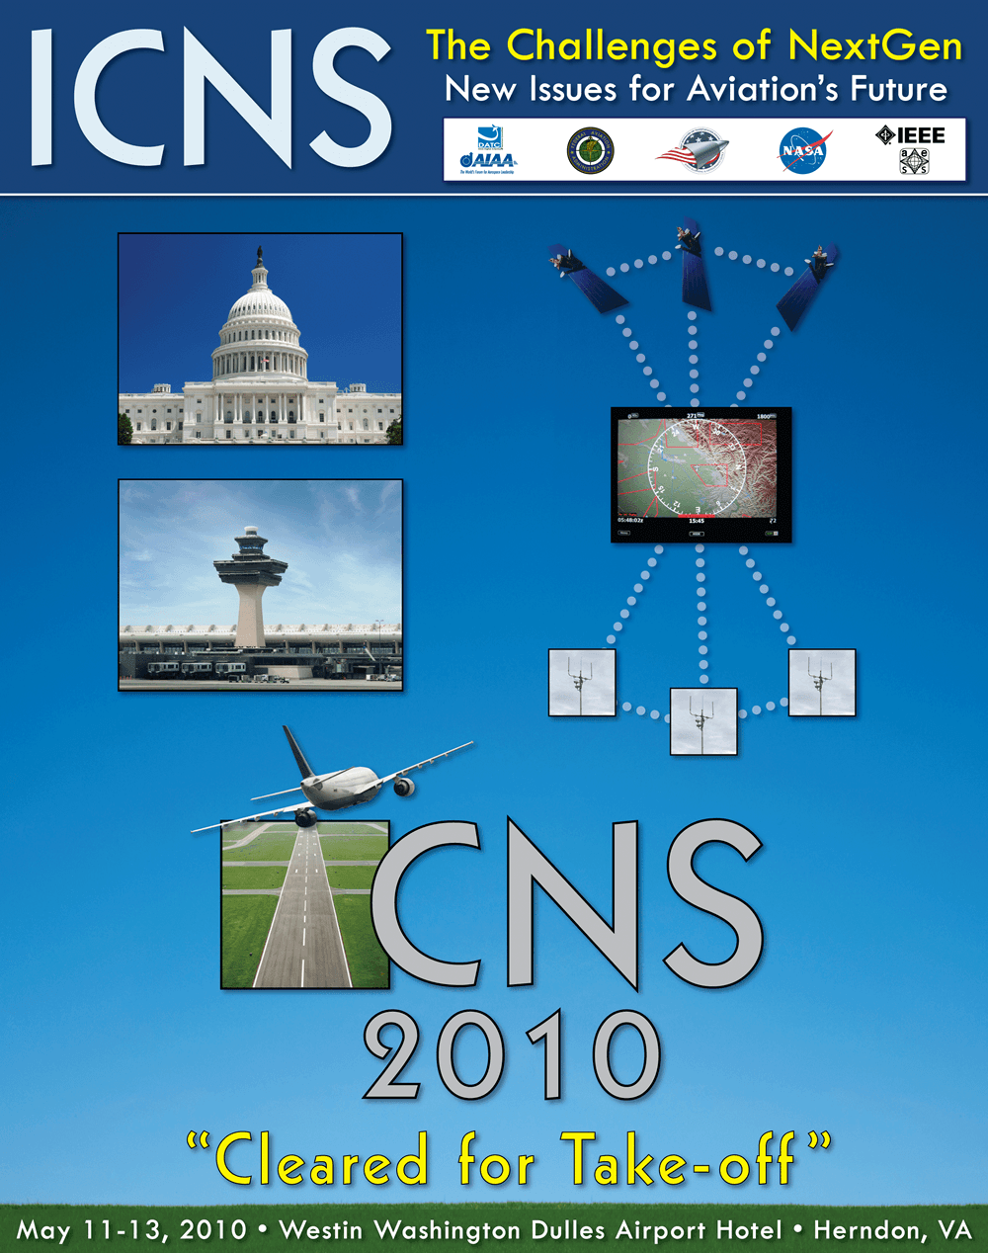

Slide 11
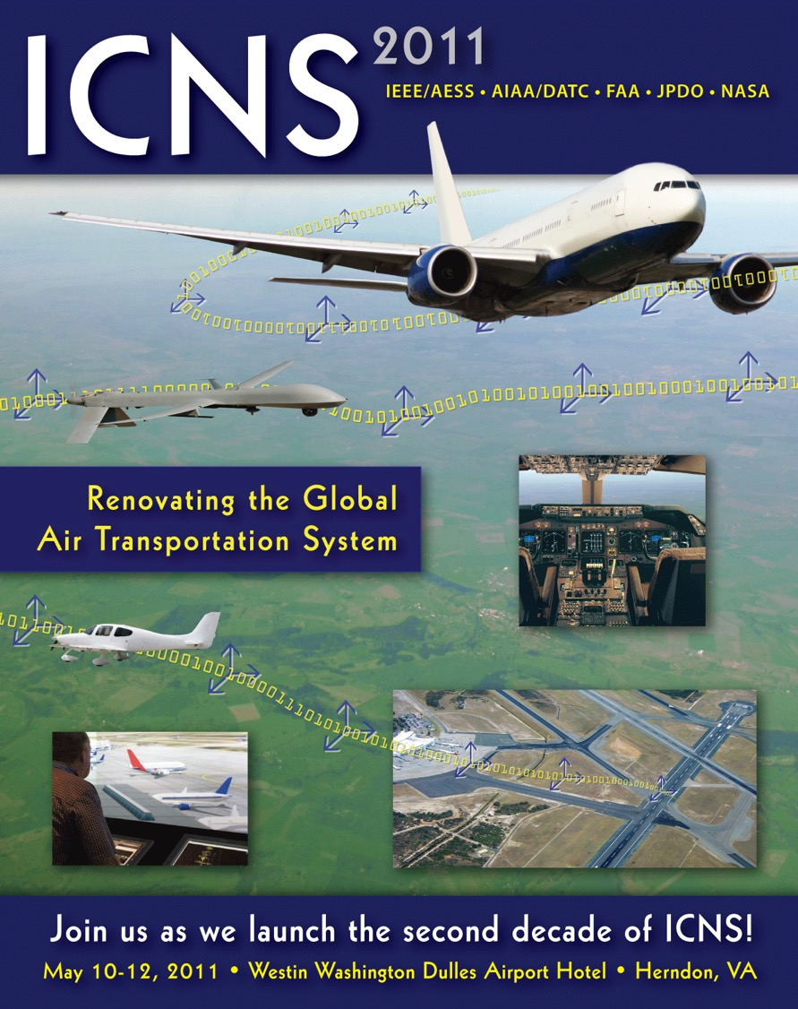

Slide 13
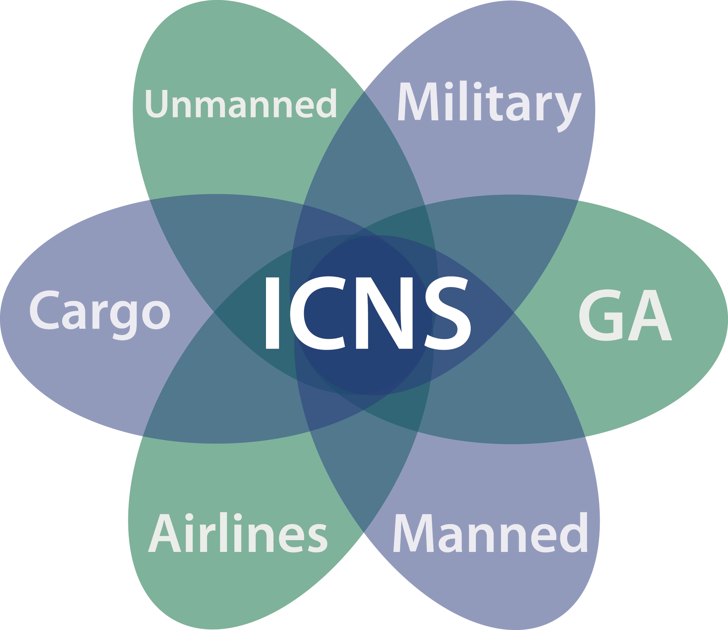
2013
Diverse Aircraft in a Common Sky – ICNS Leads the Way

Slide 14
2014
Blocks and Builds – Air and Ground Convergence

Slide 15
2015 Integrated Communication Navigation and Surveillance Conference
Innovation in Operations, Implementation Benefits and Integration of the CNS Infrastructure

Slide 16
2016

Slide 17
2017

Slide 18
2018 Integrated Communications, Navigation,
and Surveillance Conference

Slide 19
2019

Slide 20
2020

Slide 21
2021

Slide 22
2022

Slide 23
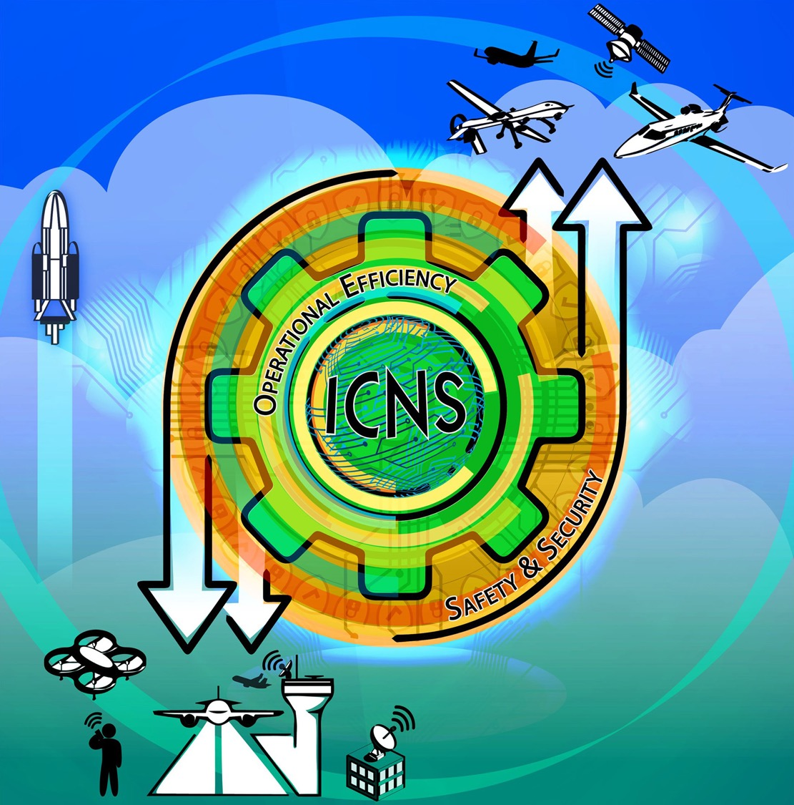
2023

Slide 26
